Slide 1
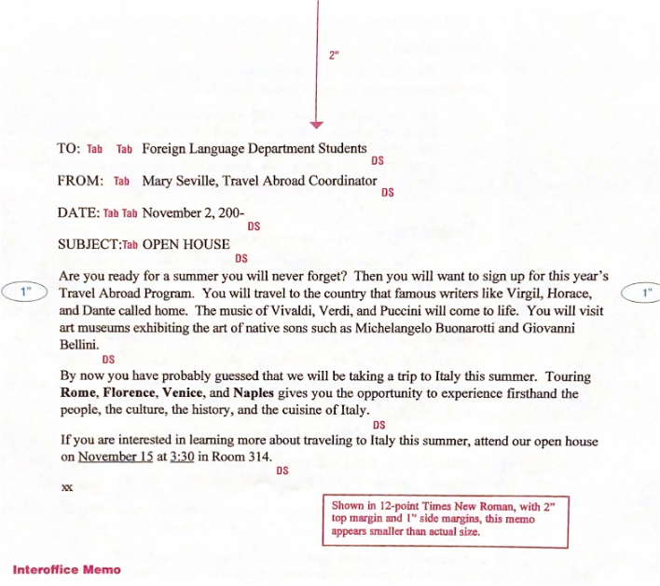
Learning to
Type & Format
Memos

Slide 2
Interoffice Memorandum (aka – memo)
Written messages used by employees within an organization to communication with one another.
Standard Memo Format
  Top Margin = 2”
  Side Margin = 1”
  Bottom Margin = 1”

Slide 3
Memo Heading
Memo Heading Includes
  TO - who the memo is being sent to (Initial Caps)
  FROM - who the memo is from (Initial Caps)
  DATE - the date the memo is being sent (Initial Caps)
  SUBJECT - WHAT THE MEMO IS ABOUT (ALL CAPS)
All Titles are typed in ALL CAPS.
  Begin all lines of the heading at the left margin.
  Line up all text with striking the Tab Key.
      TO: All Students
      FROM: Mrs. Ellsworth
      DATE: October 20, 2020
      SUBJECT: ALL CAPS

Slide 4
Memo Body
Paragraphs in the memo all begin at the left margin and are single spaced (ss) with a double space (ds) between paragraphs.
Reference Initials – If someone other than the writer of the memo types it, his/her initials are typed in lowercase letters at the left margin, a double space below the body of the memo.
Attachment Notation – If another document is attached to the memo, the word “Attachment” is typed at the left margin, a double space (ds) below the reference initials (or below the last line of the body if reference initials are not used.
  xx = your reference initials – type your initials
Enclosure Notation – If a document accompanies the memo but is not attached to it, type the word Enclosure

Slide 5
Memo Format
Book pg. 60

Slide 6
Email (electronic mail)
Email is used in most business organizations in place of memos.
It is quicker to send an email message than mail a memo.
  If sent with the appropriate address, email messages are delivered instantly even if it is sent across oceans.
The format used for email is very similar to that used for memos.
Emails may also include
  CC – carbon copy – for your information
  BCC – blind carbon copy – secretly for your information
  Delivery and return receipts can also be added

Slide 7
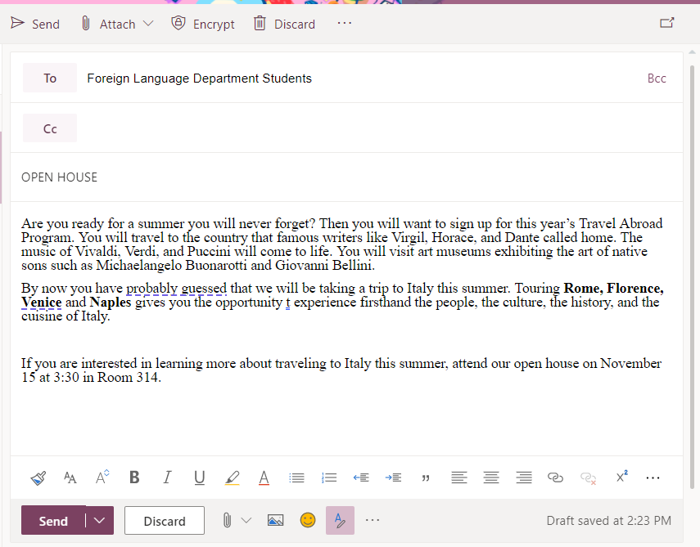
vs.
Memo
Email

Slide 8
How to Format a Memo
Select all (ctrl a)
Set up your spacing.
Formatting Font
  Courier New, Size 12
Formatting Margins
  Add a header with your name and project name
  Top margin: 2”
  Left, right and bottom margins: 1”
One space after a period and comma.
Insert a page break (ctrl enter) at the end of each memo.

Slide 9
Remember Your Shortcuts
Ctrl s – save
Ctrl a – selects all
Ctrl z - undo
Ctrl c - copy
Ctrl x – cut
Ctrl v – paste
Ctrl p – print
Ctrl b – bold
Ctrl I – italics
Ctrl u - underline

Slide 10
Memo Project
Save in O365 (One Drive) as memos
Memo 1 – pg. 60
Memo 2 – pg. 61 – top of page
Memo 3 – pg. 61 – bottom of page
Memo 4 –pg. 64
Memo 5 – pg. 65 – top of page
Memo 6 – pg. 65 – bottom of page

Slide 11
Memo 1 pg. 60

Slide 12
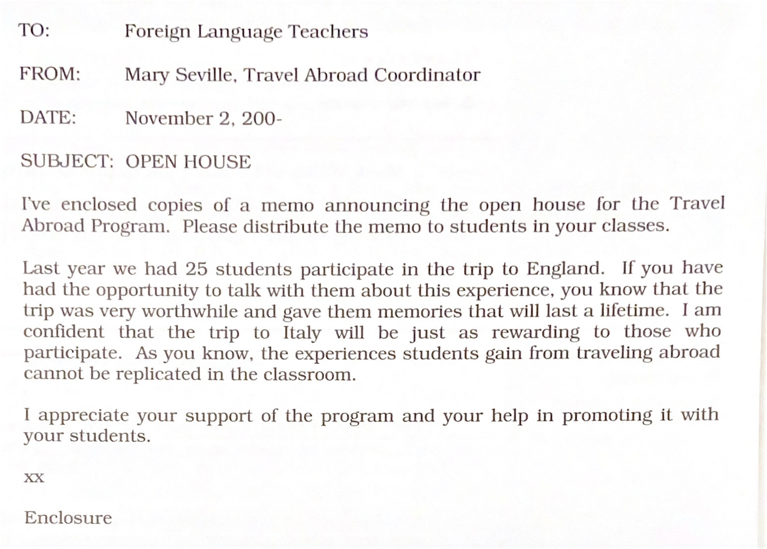
Memo 2 pg. 61 – top of page

Slide 13
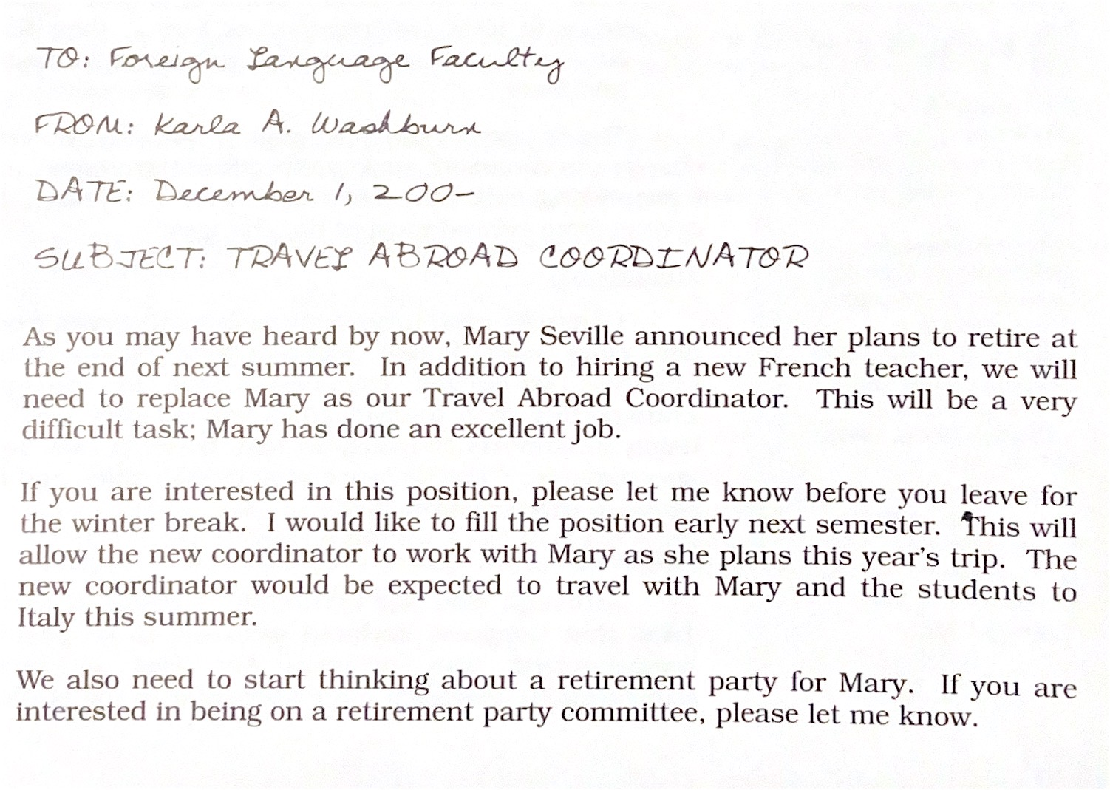
Memo 3 pg. 61 - bottom of page

Slide 14
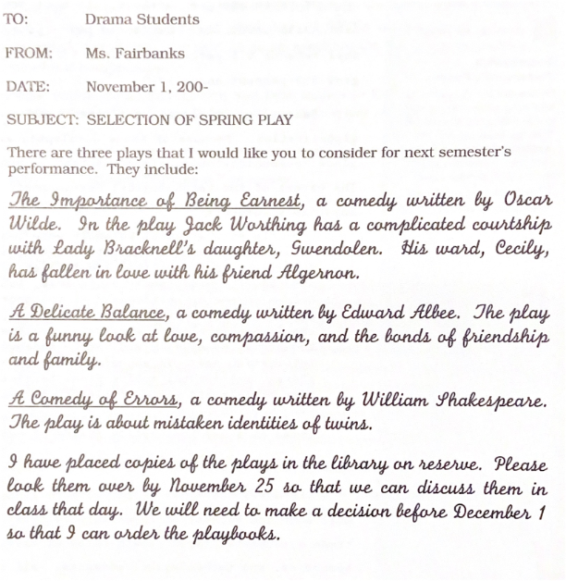
Memo 4 pg. 64

Slide 15
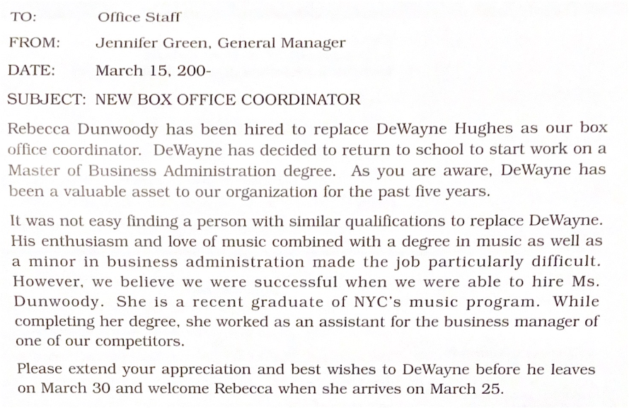
Memo 5 pg. 65 – top of page

Slide 16
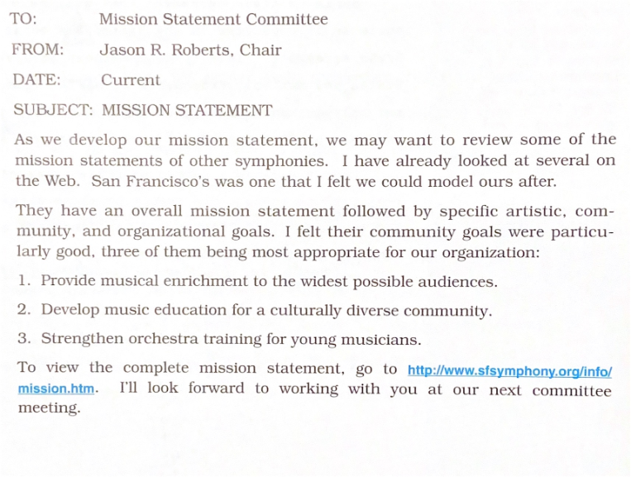
Memo 6 pg. 65 – bottom of page

